Slide 1

E-commerce shopping website Using Html,Css Under the guidence of MR.Chittranjan Gosh Trainer of Edubridge
EduBridge Learning Pvt Ltd
Presented by
Rongali swathi
FSD(5762 batch)

Slide 2
Contents
Objective
Functionalities
Technologies used
Code explanation
Desire output
Run the project demo explanation
Queries

Slide 3
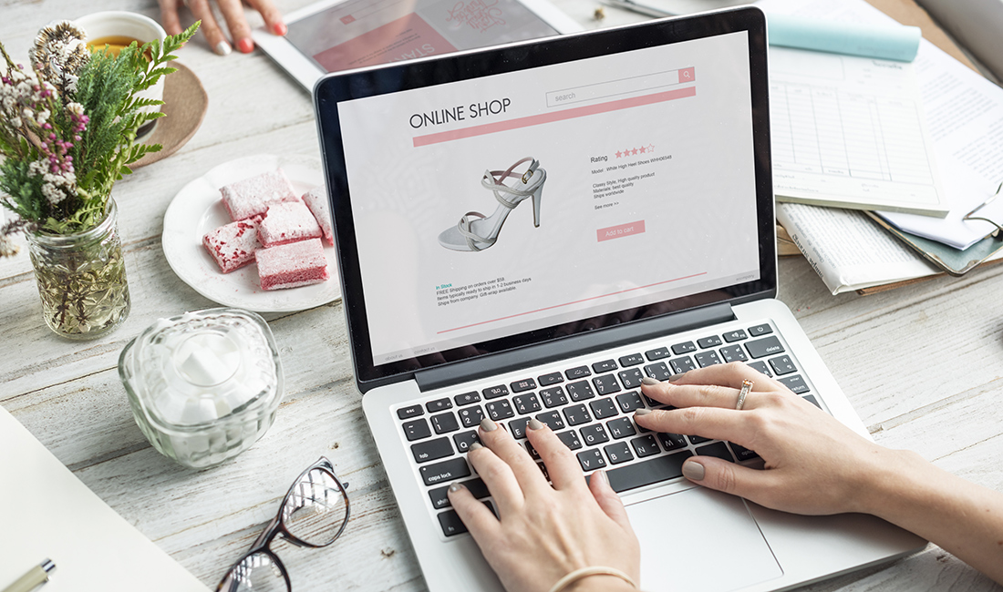
Objective
The templates make the process of building the ecommerce website easy for everyone. It decides the look and feel of your online storefront, which is the entry gate for your ecommerce store.

Slide 4
Functionalities
The major functionalities involved in E-commerce website are as follows
User-friendly
High resolution Pictures
Special offers
Gender Section
Login page
Contact us
Business-Logo

Slide 5
User-friendly
The objective is to help shoppers get to what they want faster and without running into unnecessary complexity that can clog up the path to purchase. Online sellers have minutes, if not seconds, to make a sale. Focus on the user experience by providing shopping categories, filters, and comparison capabilities.
High resolution Pictures
Humans are visual creatures. This is one of the reasons smartphones and social media are such mainstream staples of the modern era. Likewise, visual shopping experiences are crucial for online consumers. Having quality photos for ecommerce is the primary draw to attract people to your product. A product photo should include instant information such as size, color and possibly even use. Showing multiple angles of the product is also beneficial. When a buyer is left to wonder what the other side of the product looks like, they become less confident in their purchasing of decision

Slide 6
Special offers
Offering promotions and special offers to your potential customers is an effective method of driving ancillary traffic to your site, acquiring new customers, and increasing online sales and revenue. Best of all, these online sales can also be used to encourage new visitors to become loyal, repeat customers.
Gender Section
You’re going to need to know the specifics of how different genders shop if you want to provide a service that satisfies their needs. For instance, men tend to prefer a more straightforward shopping experience. Think of Amazon’s 1-click as being the holy grail of male shopping preferences. Women, on the other hand, desire both a social and comprehensive shopping experience.

Slide 7
Login page
A login page is of extreme importance to web and app design, especially for online stores or e-commerce websites. A creative and attractive login page will quickly catch the user’s attention, direct a high volume of visitors to your website, and increase the customer base. Most login pages include elements such as username and password.
Contact us
Contact us pages are often the go-to for a new visitor on a mission. It's where they go when they have a question and truly want to speak to an individual at your organization. They exist to serve the user with the purpose of providing them with information on how they can get in touch with you
Business logo
A company logo is a symbol of your company's identity. It creates your customers' first impression of your company

Slide 8
Technologies used
Html(Hyper Text Markup Language)
Hypertext Markup Language (HTML) is a computer language that makes up most web pages and online applications. A hypertext is a text that is used to reference other pieces of text, while a markup language is a series of markings that tells web servers the style and structure of a document. The three main parts of an element are:
Opening tag – used to state where an element starts to take effect. The tag is wrapped with opening and closing angle brackets. For example, use the start tag <p> to create a paragraph.
Content – this is the output that other users see.
Closing tag – the same as the opening tag, but with a forward slash before the element name. For example, </p> to end a paragraph.
CSS (Cascading Style Sheets)
CSS is designed to make style sheets for the web. It is independent of HTML and can be used with any XML-based markup language. It is the language for describing the presentation of Web pages, including colours, layout, and fonts, thus making our web pages presentable to the users.

Slide 9
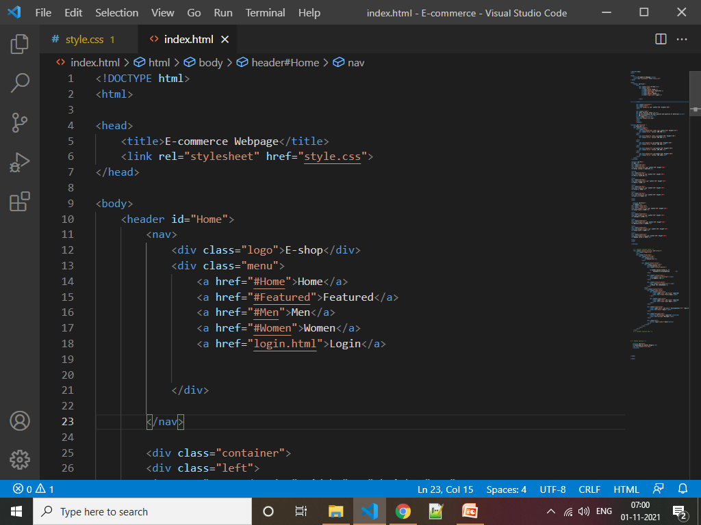
Code Explanation

Slide 10
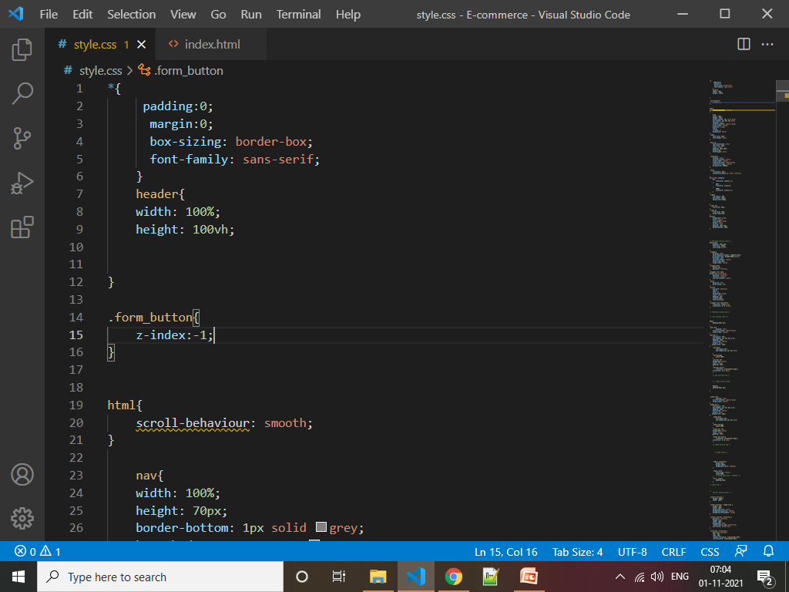

Slide 11
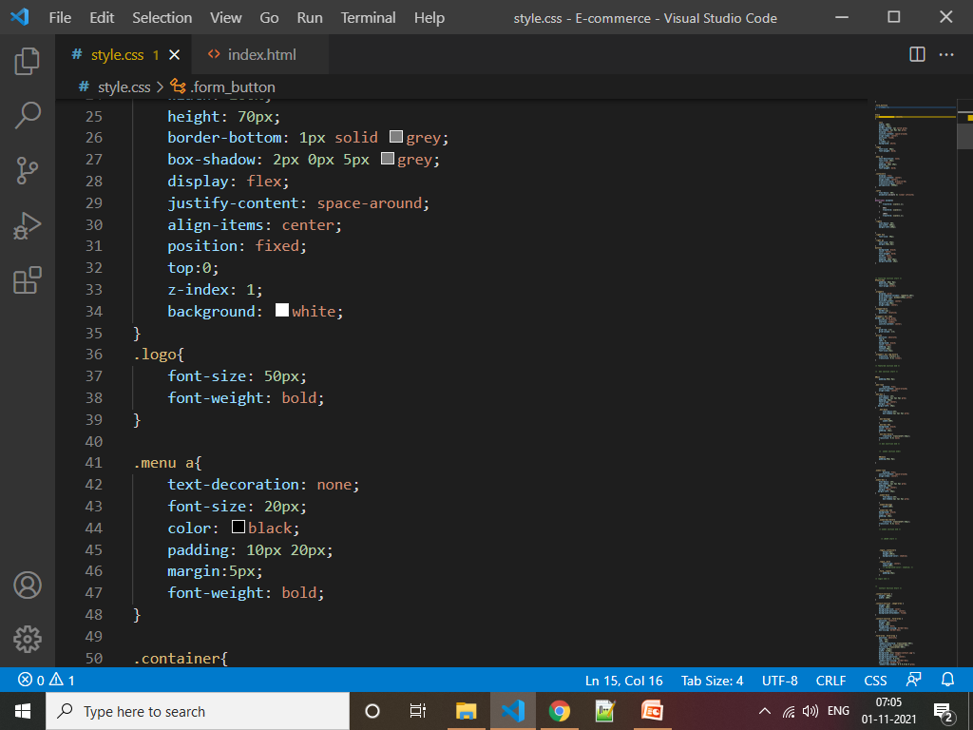

Slide 12
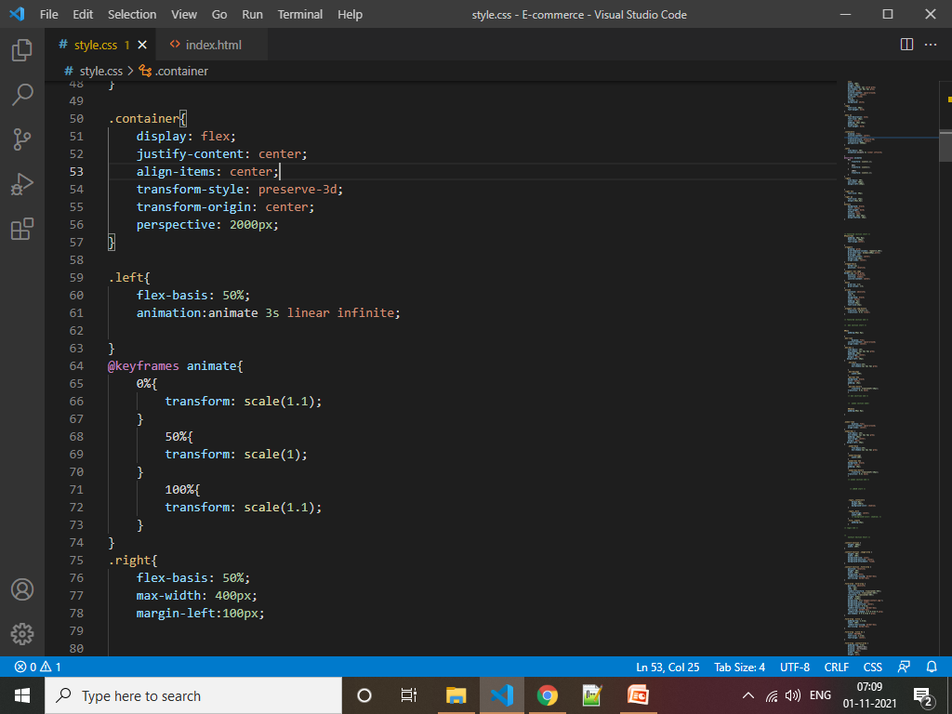

Slide 13
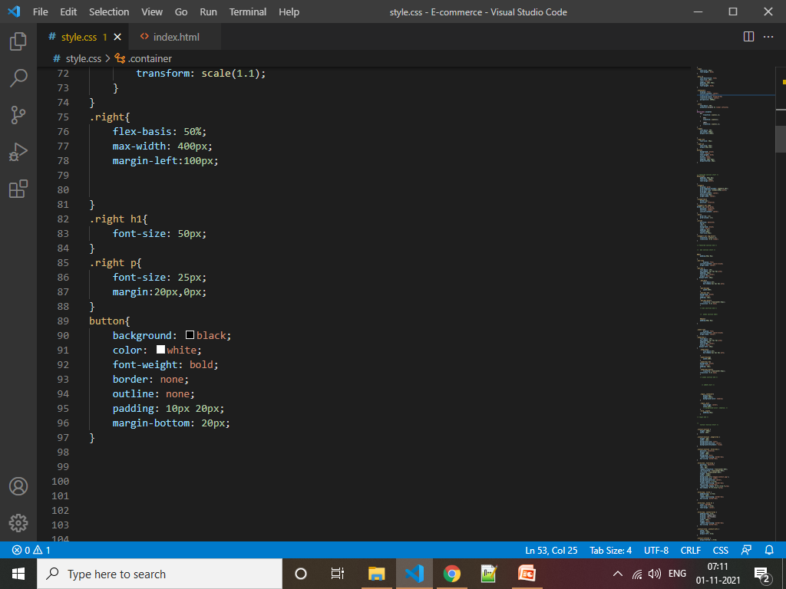

Slide 14
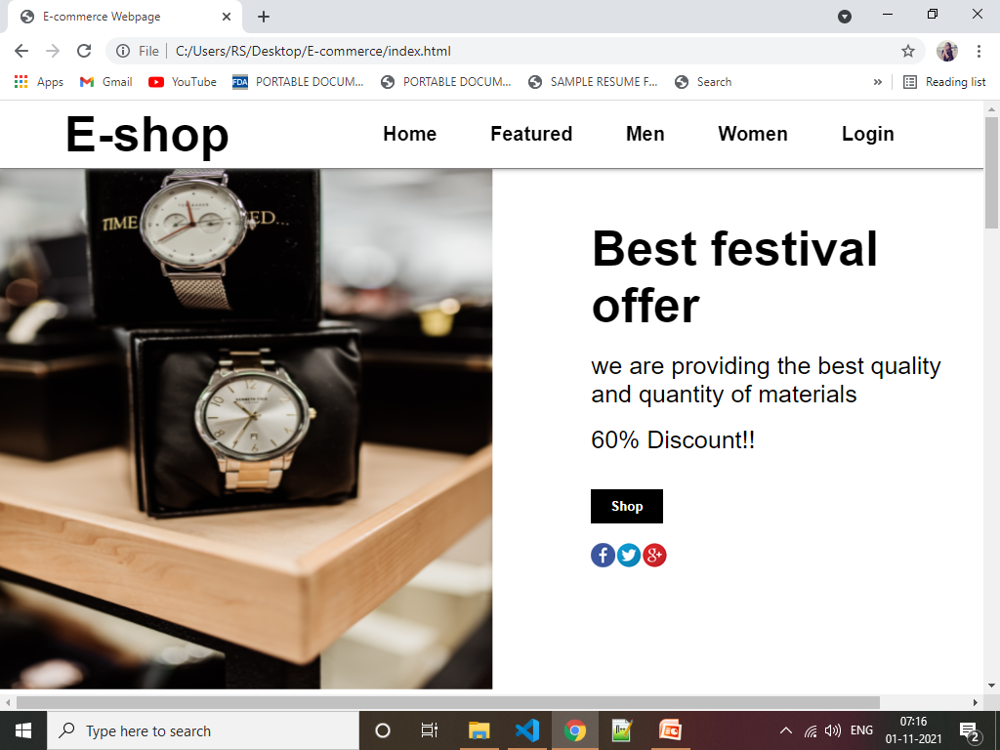
Output

Slide 15


Slide 16


